Slide 1
15 October 2015
Forecasting for later today… it is now 0900 UTC

Slide 2
NWP based tools

Slide 3
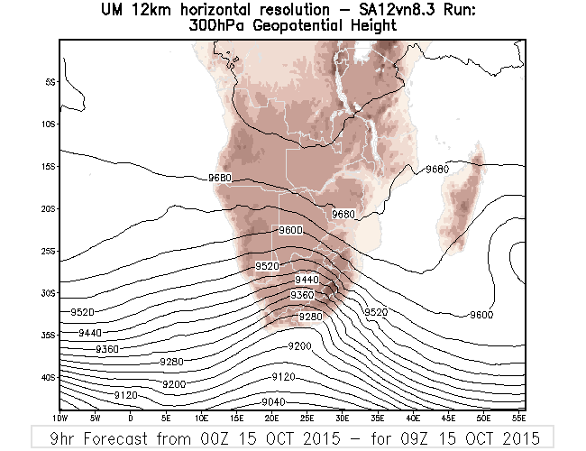
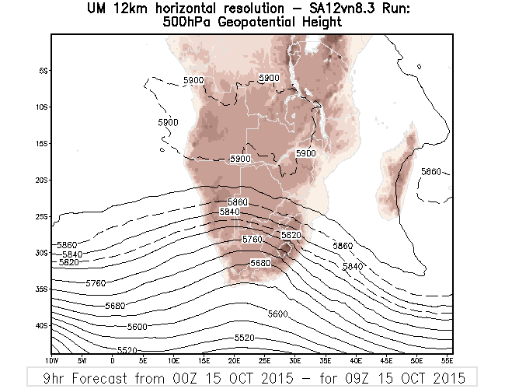
NWP at 0900 UTC

Slide 4
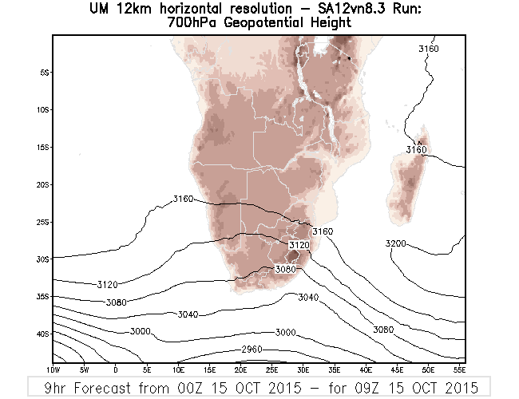
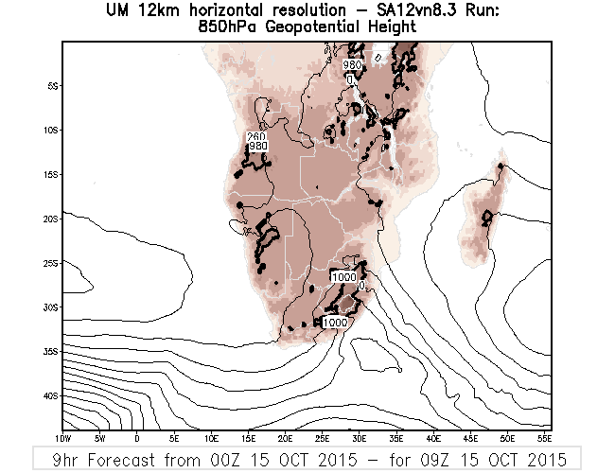
NWP at 0900 UTC

Slide 5
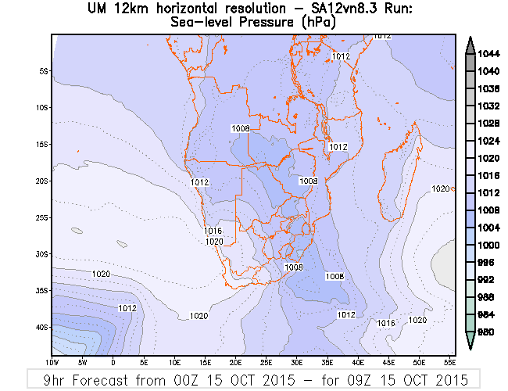
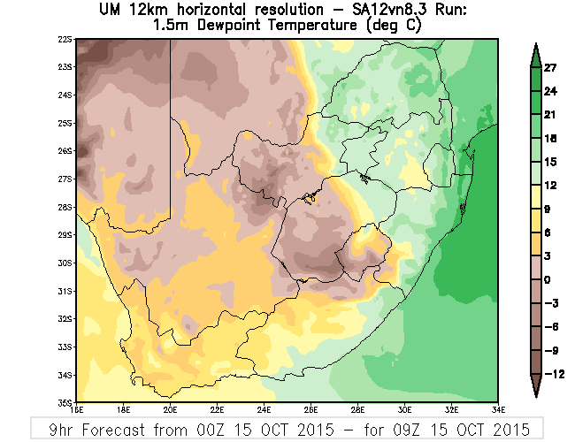
NWP at 0900 UTC

Slide 6
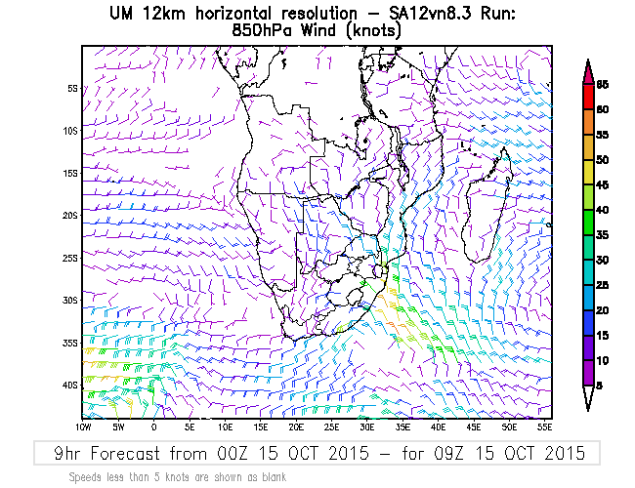
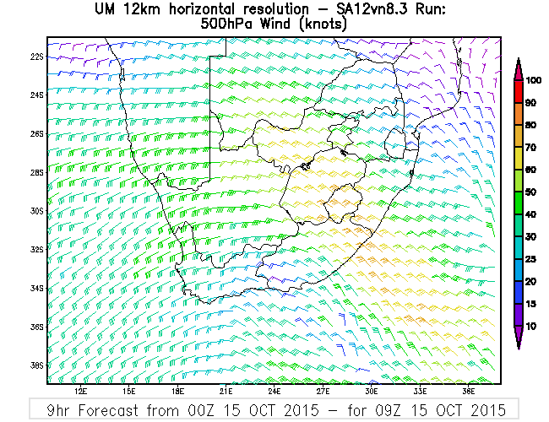
NWP at 0900 UTC

Slide 7
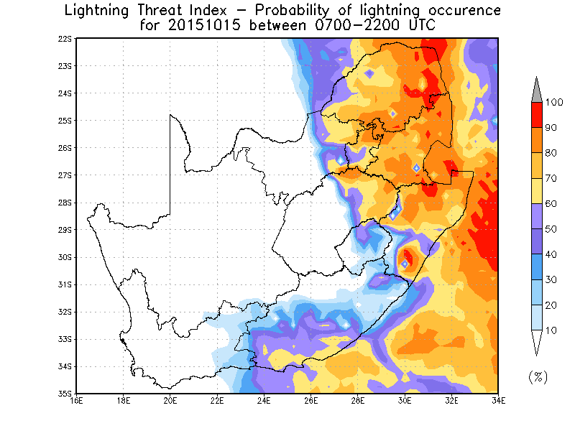
LTI

Slide 8
Remote sensing tools MSG images

Slide 9
MSG at 0900 UTC Convection RGB

Slide 10
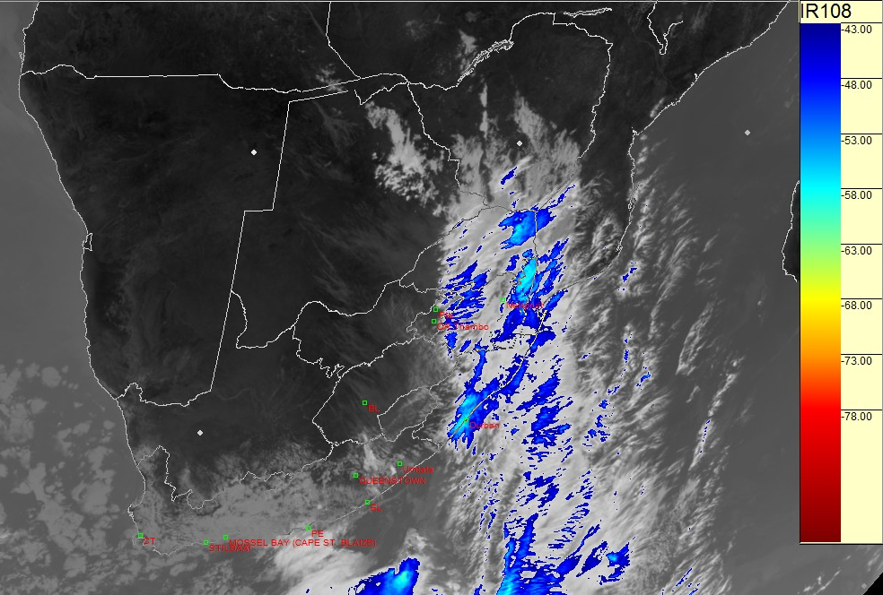
MSG at 0900 UTC IR108

Slide 11
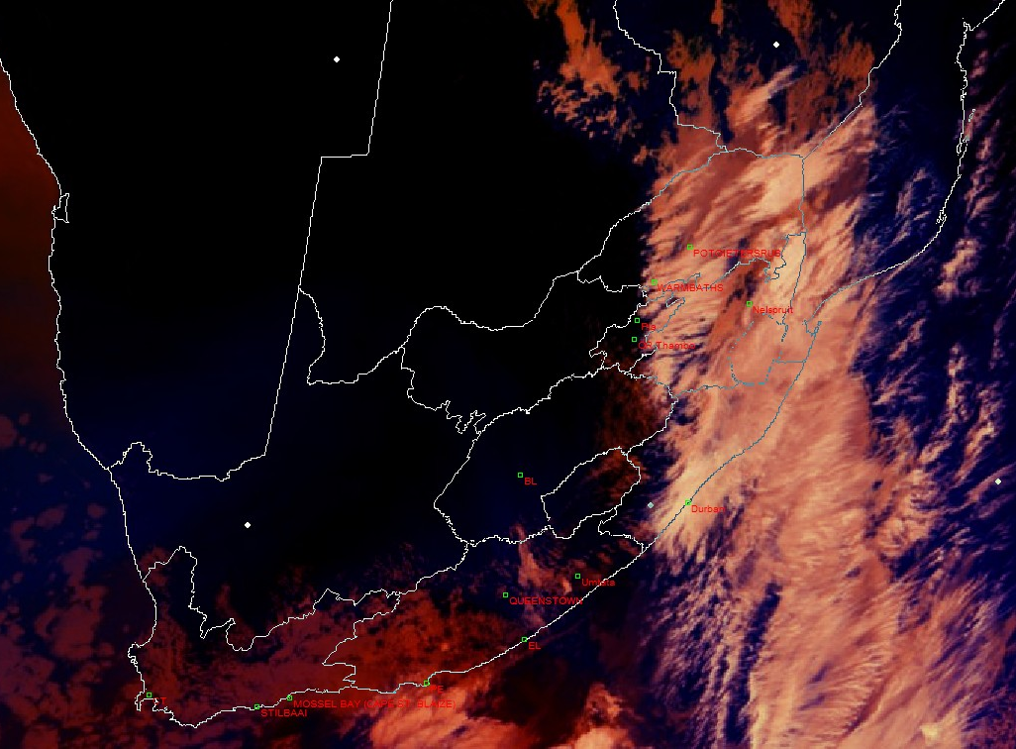
MSG at 0900 UTC OT RGB

Slide 12
Remote sensing and NWP blended products

Slide 13
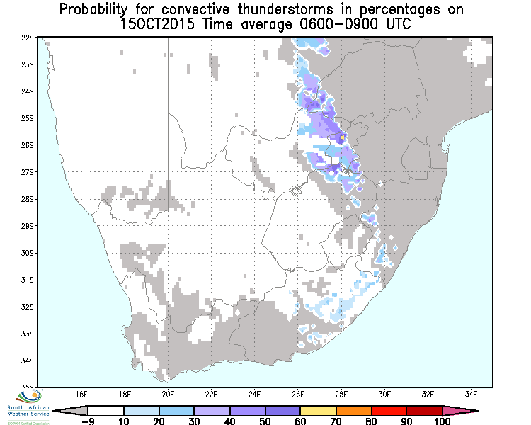
CII at 0900 UTC

Slide 14
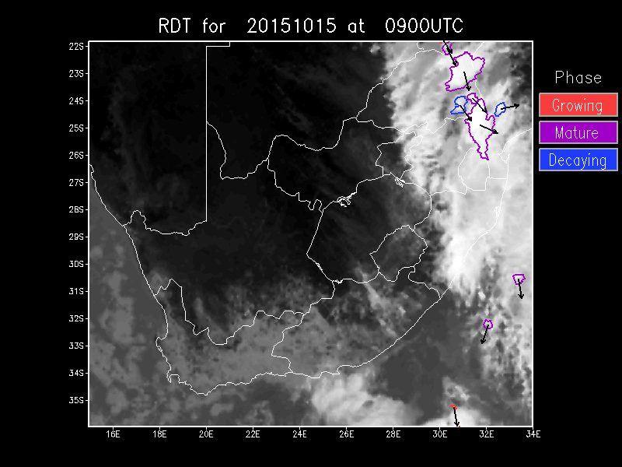
RDT at 0900 UTC

Slide 15
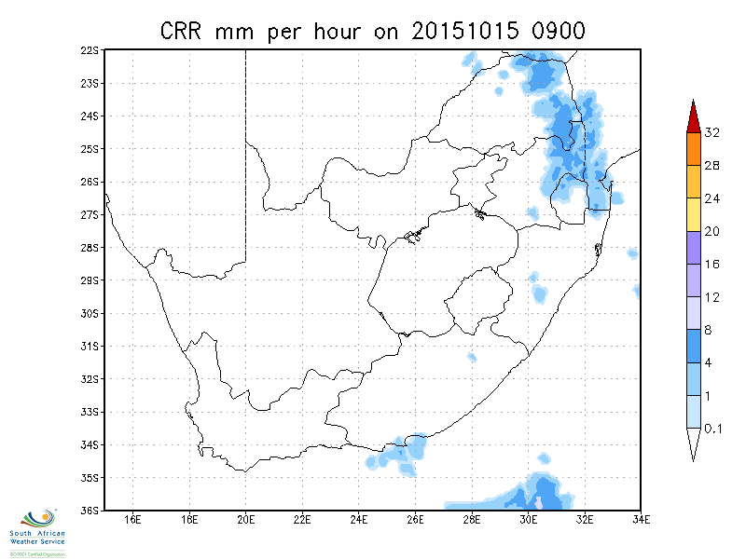
CRR at 0900 UTC

Slide 16
1. Looking at the provided fields where would you expect convection later in the day (after 1200 UTC)?
How did remote sensing and blended field provide MORE information than just the NWP?
2. Use the map provided to draw an area where you expect convective development and give probabilities – e.g. 30%, 60%, 80% and 100% chance of convection

Slide 17
0900 UTC
Expectation for later in this day

